Slide 1
AST21962: Multimedia Authoring
Rai Phirens 55742987
Lam io meng 55718625
Lam Ho 55718164
Leung Ho Lun 55750987
Chan Tsz Long 55721899

Slide 2
TOC
Overview
Brief Description
Themes
Demonstration
Unique Ideas
Closing remarks

Slide 3

Brand: Converse

Slide 4
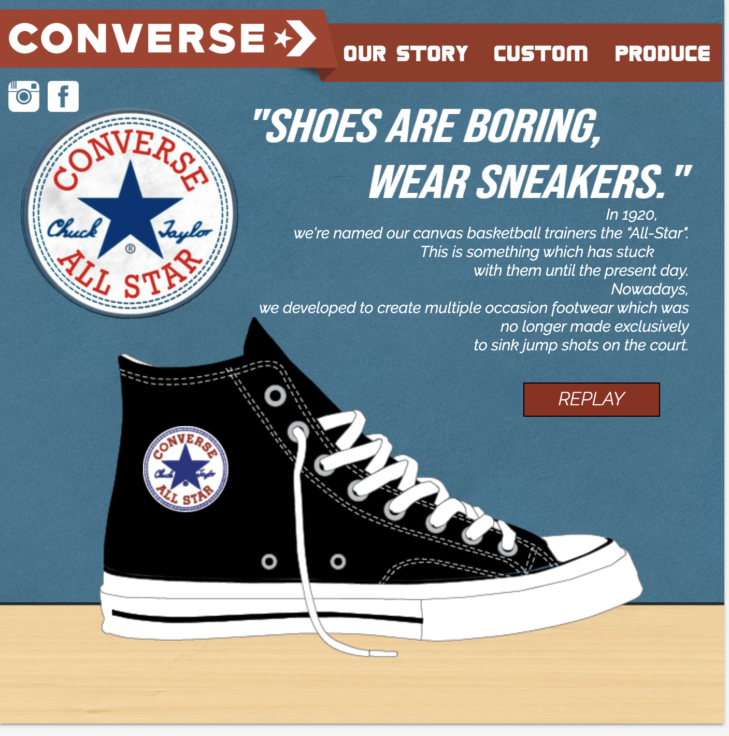
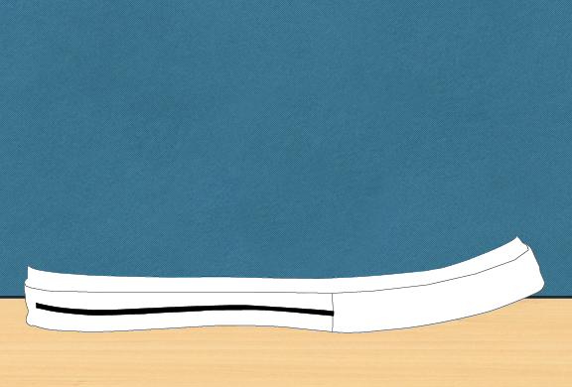
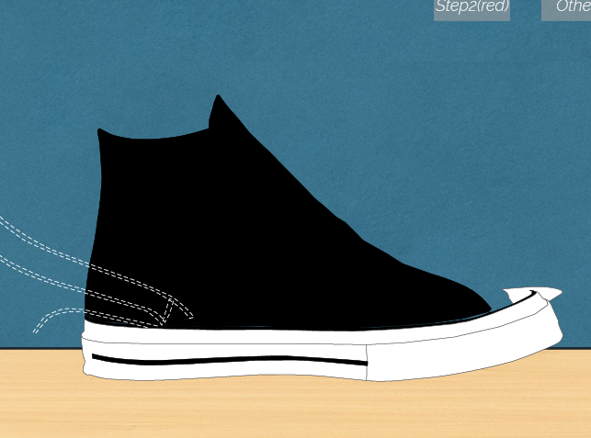
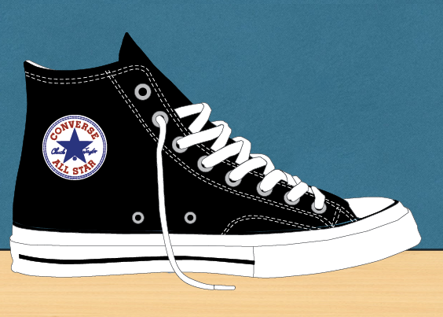
Main Page
In main page,we are using shoe assembly process animation to introduce the product
We create each small parts and use fade out,rotate to do this animation

Slide 5

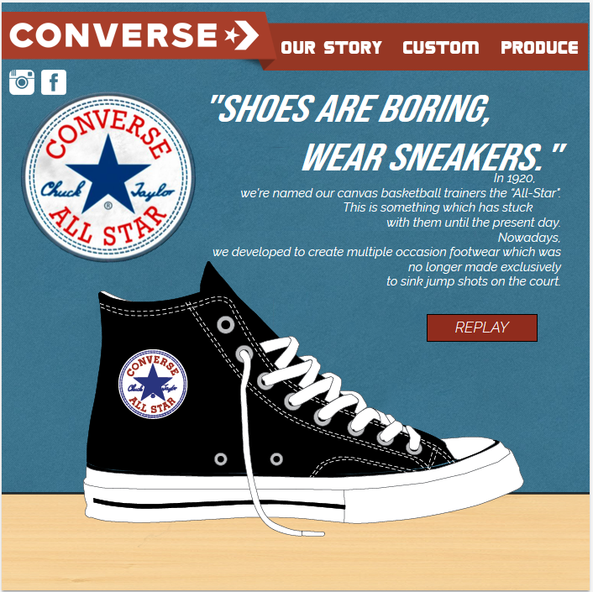
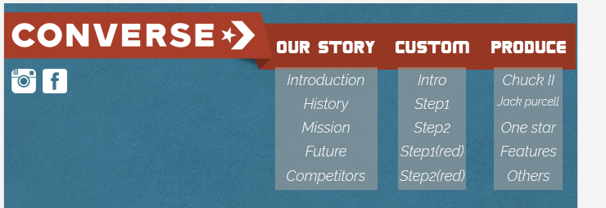
Main page
And we have menu bar on the top,which are “Our story”,”Custom” and “Product”,each sub-sections have 5 sub-page

Slide 6
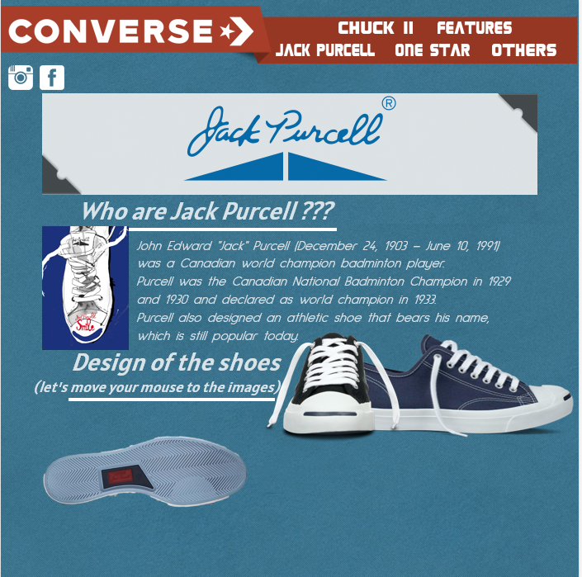
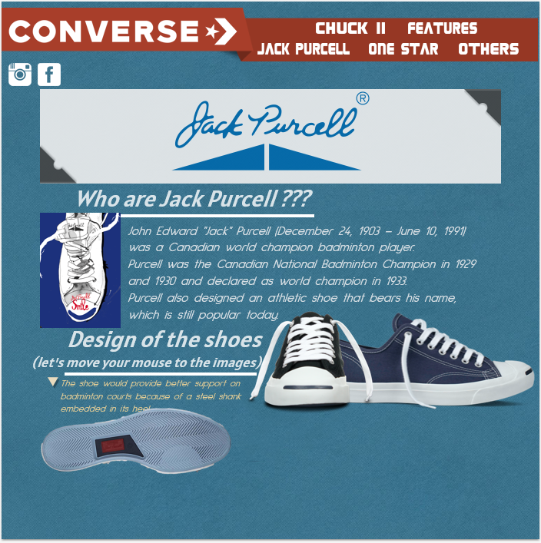
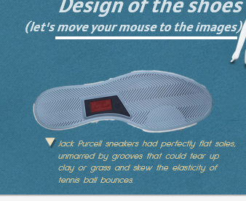
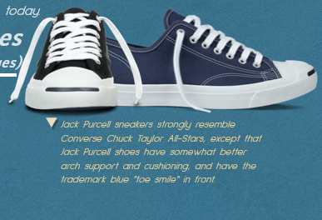
Sub-sections:Our story
We use mouseover function , user can move the mouse to know more information about the design of the shoe
Introduction

Slide 7
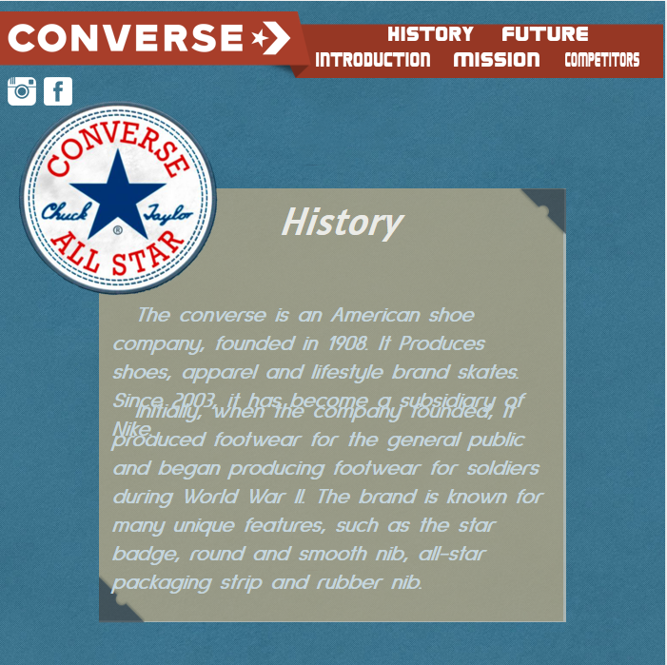
Sub-sections:Our story
History

Slide 8
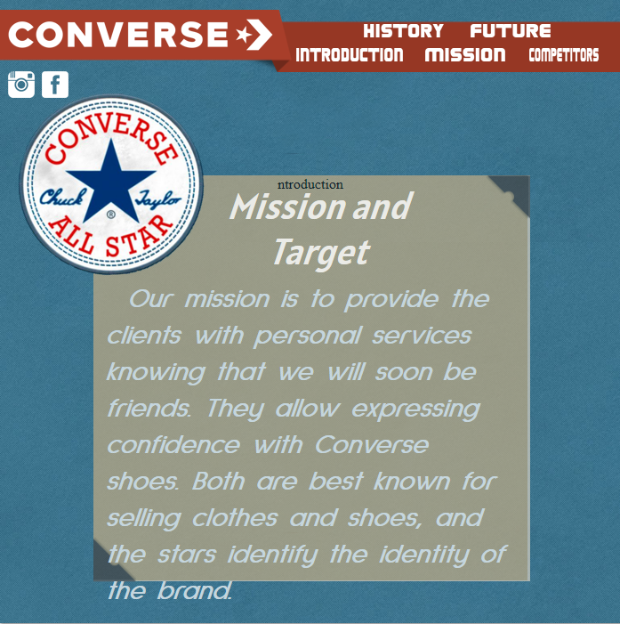
Sub-sections:Our story
Mission

Slide 9
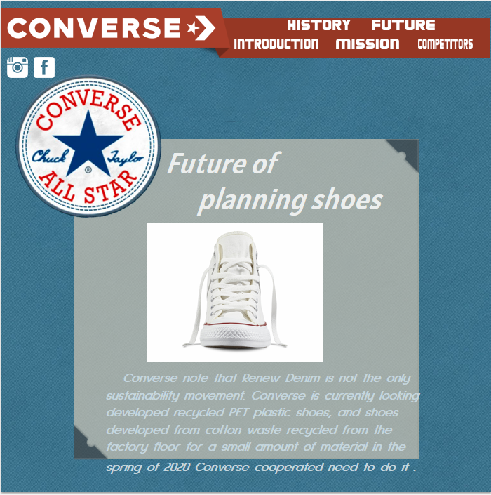
Sub-sections:Our story
Future

Slide 10
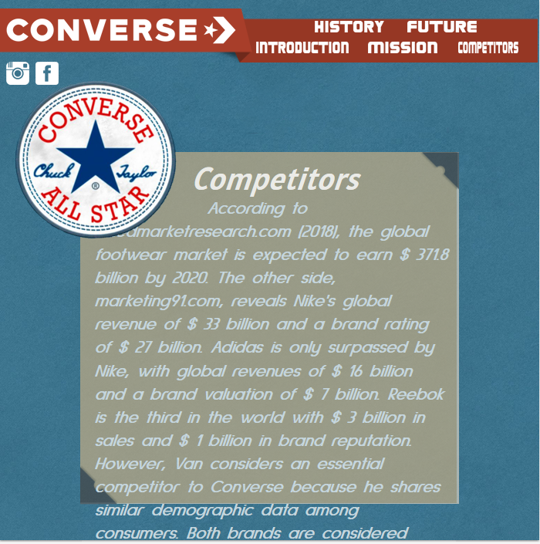
Sub-sections:Our story
Competitors

Slide 11
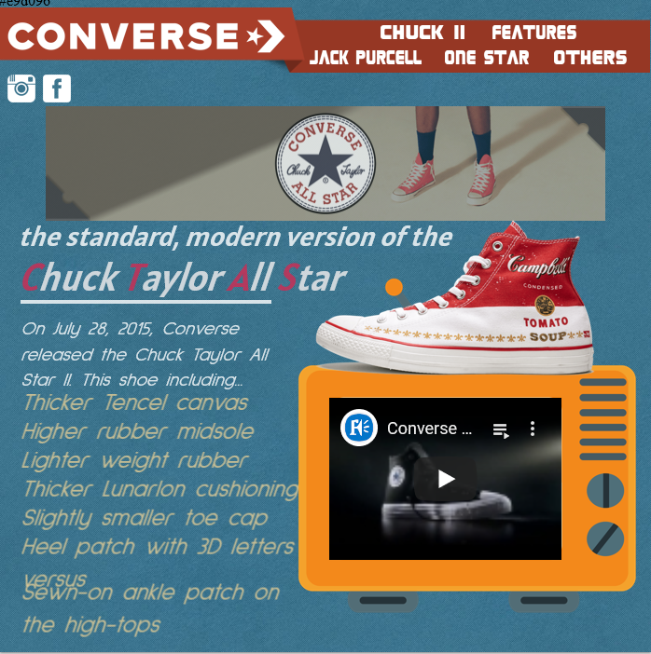
Sub-sections:Product
Chunk ll
We import some Youtube component in the page,user can watch video to know more information

Slide 12
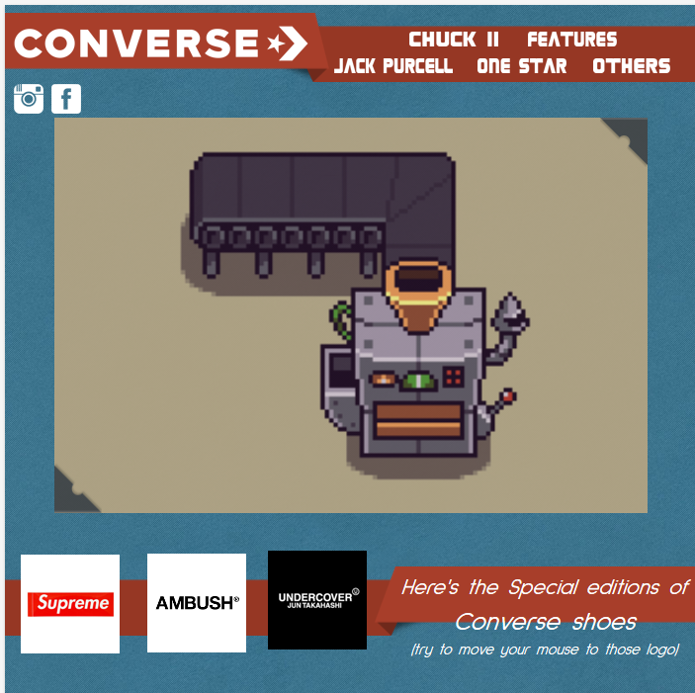
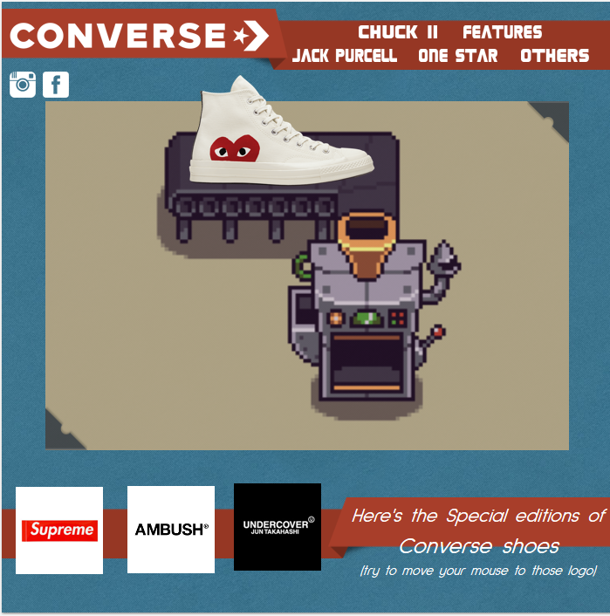
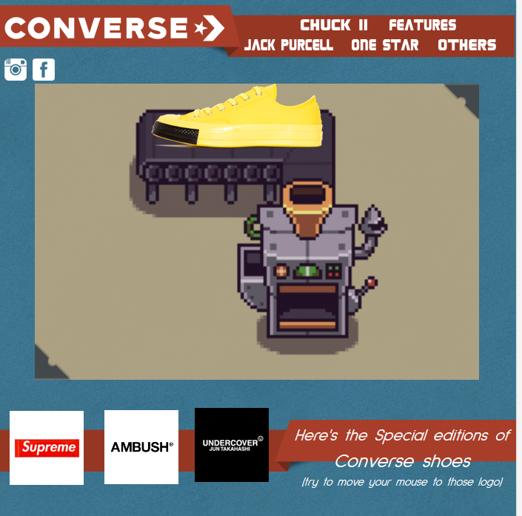
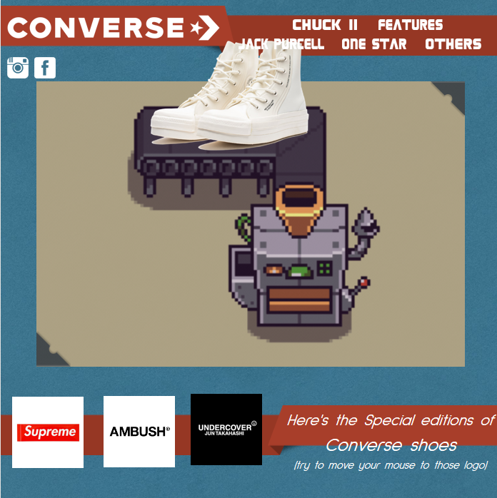
Sub-sections:Product
We use mouseover function , user can move the mouse to see different specail edition converse shoes
Features

Slide 13
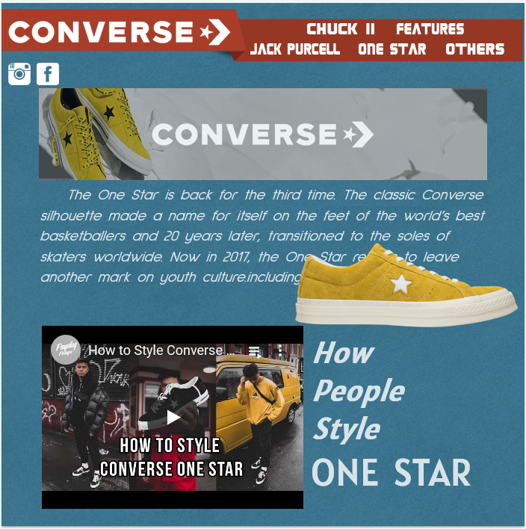
Sub-sections:Product
One Star
We import some Youtube component in the page,user can watch video to know more information.And we use some left to right ,right to left animation effect to show the text

Slide 14
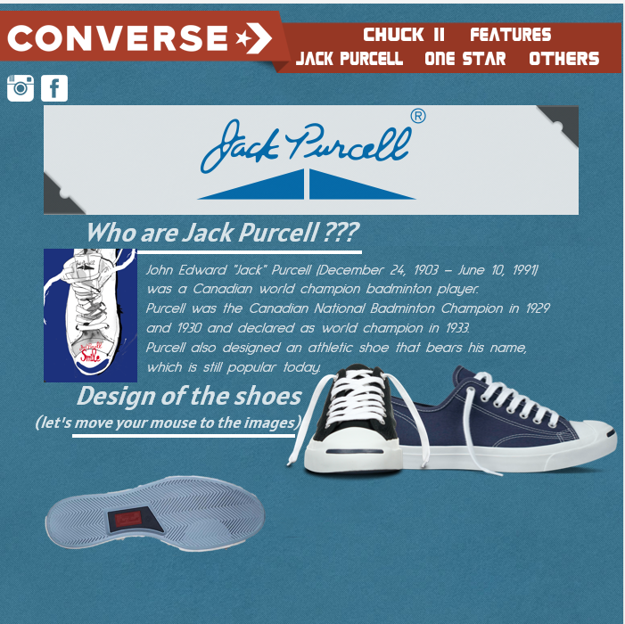
Sub-sections:Product
Jack Purcell
We use mouseover function , user can move the mouse to know more information about the design of the shoe

Slide 15
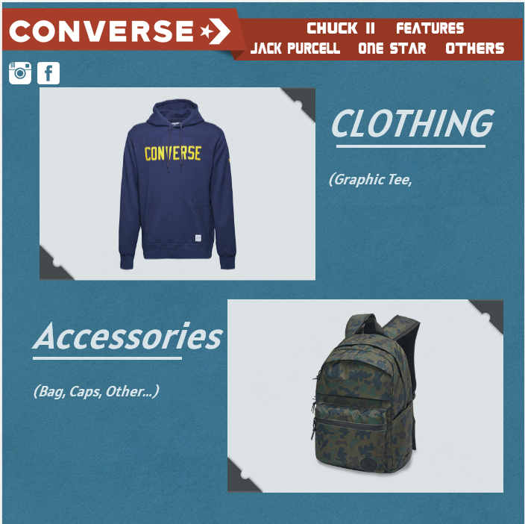
Sub-sections:Product
Others

Slide 16
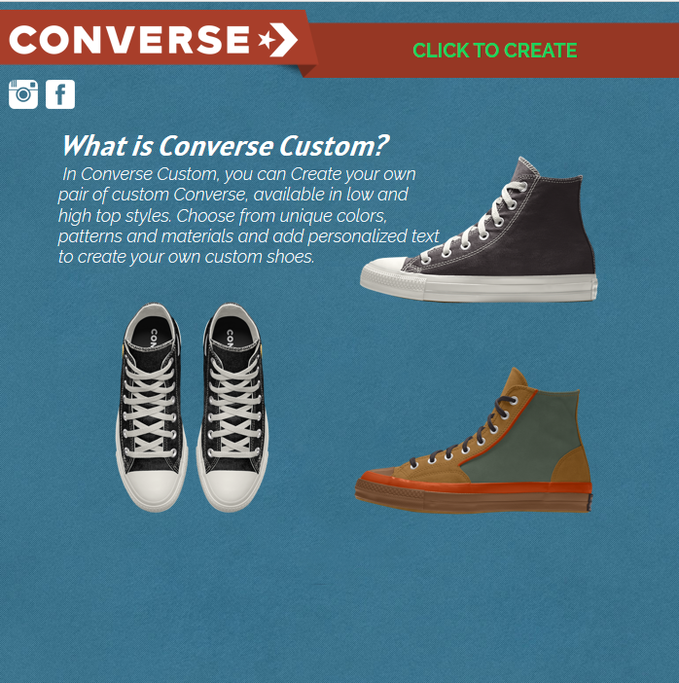
Sub-sections:Custom
This can let user to create their own shoes

Slide 17
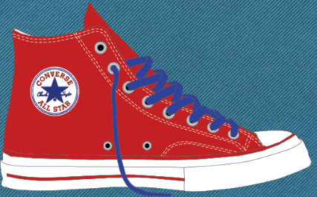
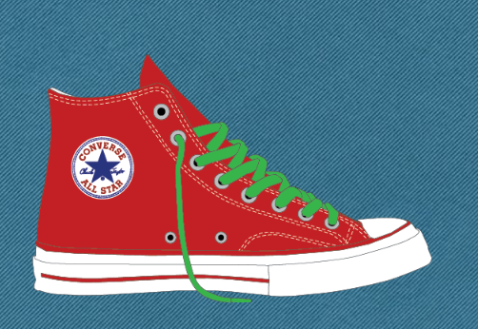
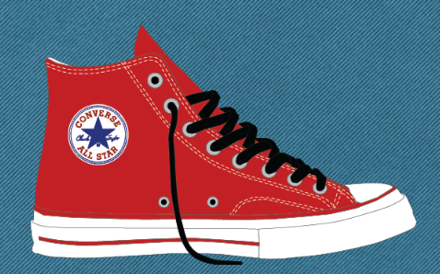
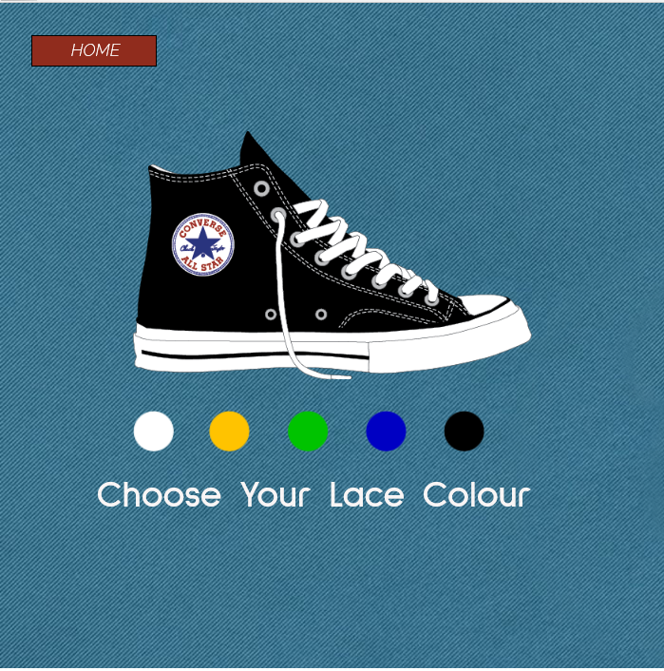
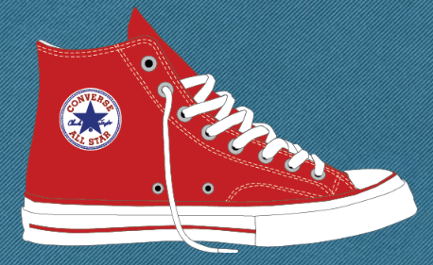
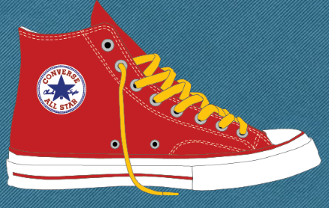
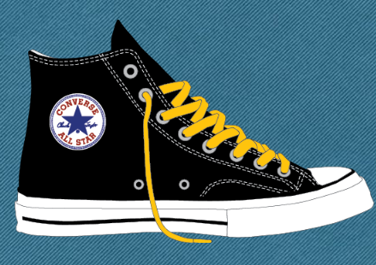
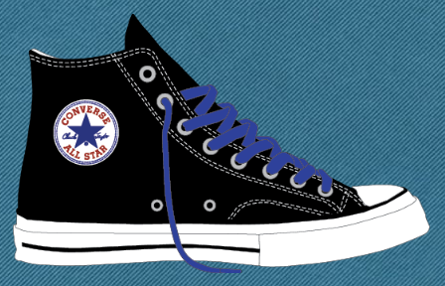
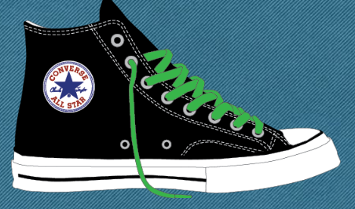
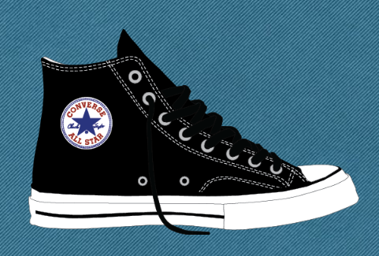
Sub-sections:Custom
This can let user to choose their favourite color

Slide 18

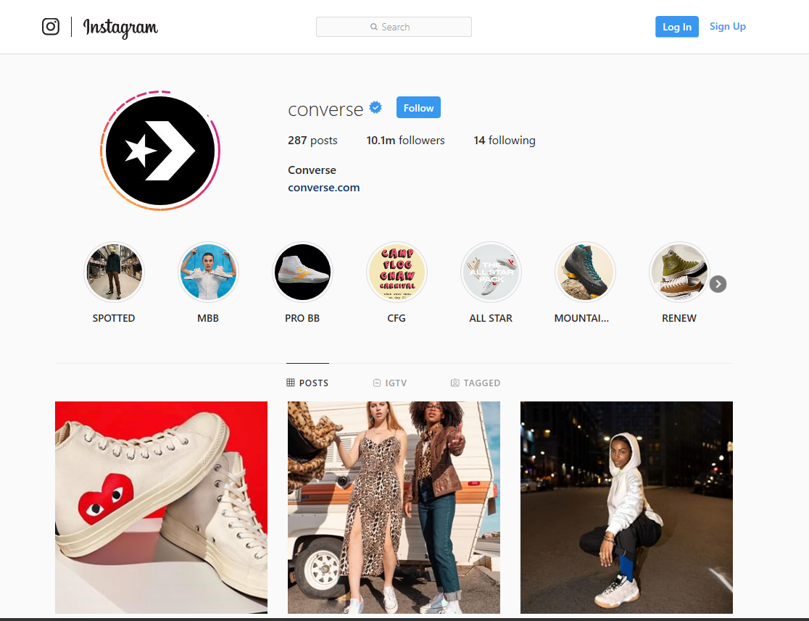
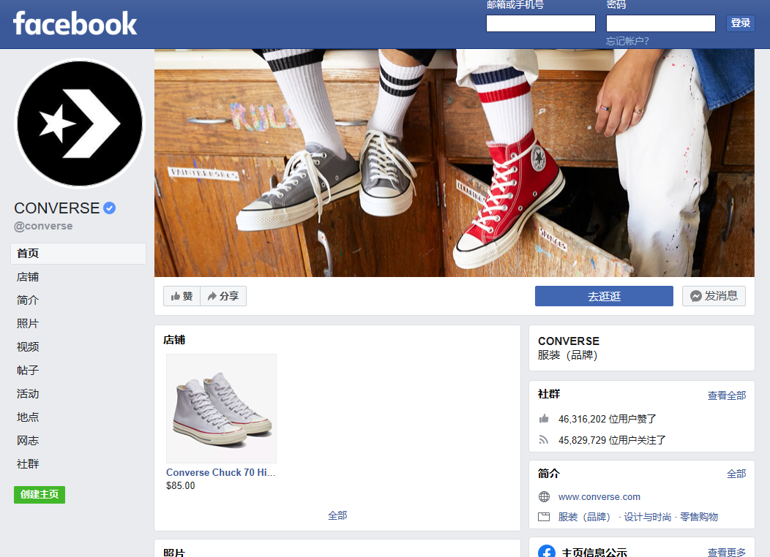
Social Media
There have some Social Media link for user to follow

Slide 19

Thank you!

